Slide 1
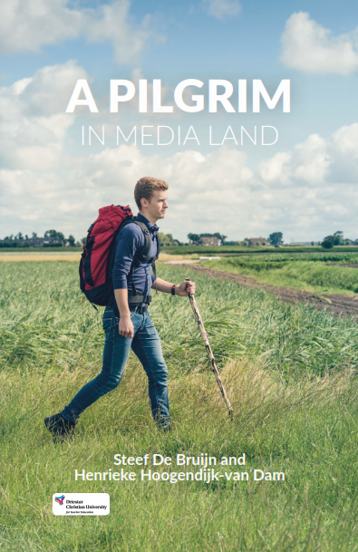

Slide 2
Introduction
Legos vs Smartphones
Traditional views and modern media
From 1997 to 2007 to today
Have traditional principles been made obsolete by modern media?
The Paradox of Media Land
Young people need their parents’ guidance, but when they are on social media, they are in a seemingly unreachable, private zone.
Deuteronomy 6:6-7
A Pilgrim
Notes:
Discussion Questions:
Compare and contrast the world of Legos with the world of smart phones. How are they similar and how different?
How can the smart phone be more addictive than a hobby or a book?
Why is the era of social media so much more difficult to morally guard against than the former era of the theatre, TV and radio?
Define “Pedagogy” by looking it up in a dictionary—or on your smart phone☹.
What should be our moral guide when living in this media world? Why?
Write out Deuteronomy 6: 6-7:
Explain how the Biblical view of being a Pilgrim is a good example in using modern media.
Why is conversion so necessary to being a true Pilgrim in media land?

Slide 3
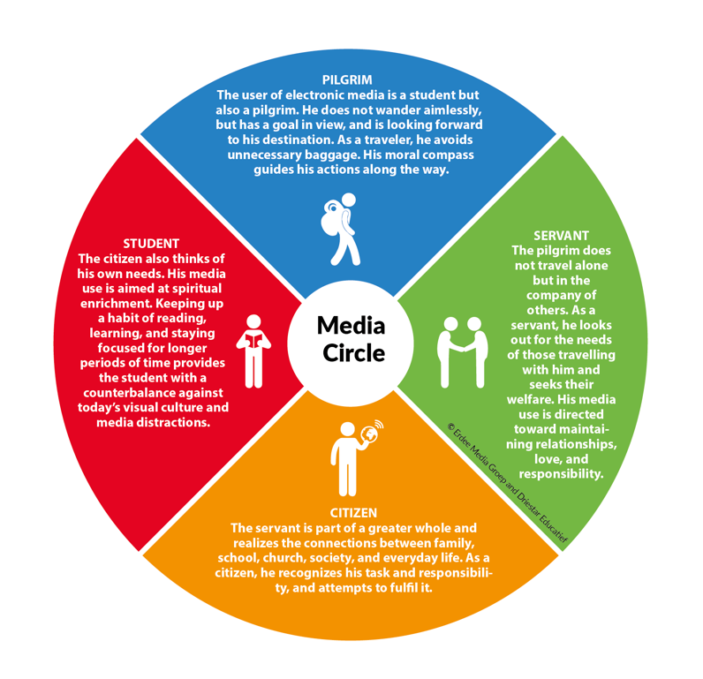
Media Circle
Notes:
Discussion Questions:
What are the four quadrants of the media circle?
Explain how they balance each other.
How does the media circle differ from secular solutions to misuse of modern media?
What is the danger if we just limit ourselves to a number of guidelines or rules?

Slide 4
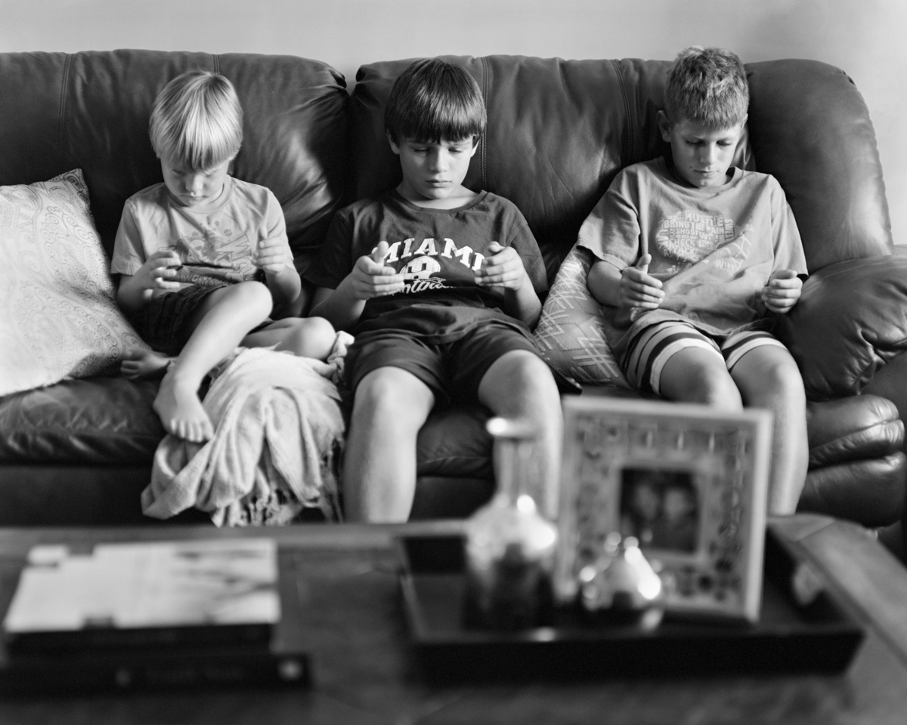
Chapter 1 – Seize the Day
About Temperance (Moderation)
Digital Fads
What does the Bible say?
Attitude of Temperance – Balancing Excessive Temperance (Abstinence) vs. Carnal Intemperance (Gluttony)
Media Conversations
Discussion Questions
Notes:
Discussion Questions:
How do media companies rouse expectations for a new electronic product?
How is 1 Corinthians 7:31 a good text to apply to modern media?
Define “temperance.”
How can we apply temperance to our whole life—not just modern media? Explain in detail.
Explain, using your book’s examples, how “excessive temperance” is also intemperate.
How does Calvin say we should use God’s creation?
How should we teach children about temperance? Use examples.
Should temperance apply to unlimited Netflix movies? Explain your answer.
Thought: Are there things in life that we should deny ourselves and not use even moderately? Explain your reasoning and give examples.
How did David’s parents exhibit discretion in bringing up their son? (The David in Chapter 1)

Slide 5
Chapter 2 – A Shield and a Helmet
About Resilience
Tools (i.e., filters) vs. communication
What does the Bible say?
Attitude of Resilience – the shield and the helmet
Media Conversations
Discussion Questions
Notes:
Discussion Questions:
How is driving without a seatbelt comparable to using the internet without a filter?
Uncle Ben and David’s father have two different opinions on a filtered internet. Who do you identify with more? Explain in detail.
What is “Discretion”? Why is it so important in media use?
Explain the two categories of “protective measures.”
How would you hypothetically respond to “your child” if “he” wanted to play Call of Duty, a shooting game where you have to kill your opponent. Use pp 36-37 to guide your answer.
How does peer pressure affect conscience forming?
How are the pressures of growing up today much more difficult from growing up in the past?
Define “Resilience.”
Explain the relationship between a tender conscience and resilience.

Slide 6
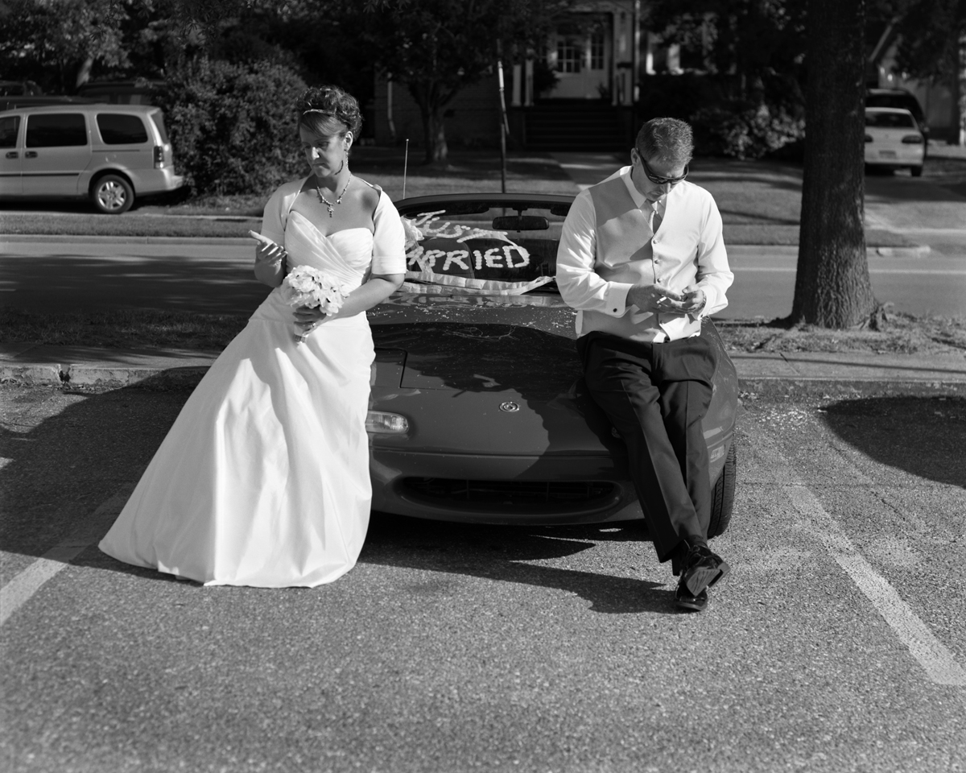
Chapter 3 – Appealing and Alluring
About Self-Control
Media addictions
What does the Bible say?
Attitude of Self-Control – denial of self
Media Conversations
Discussion Questions
Notes:
Discussion Questions:
How does electronic media affect our brain and sleep patterns? (two answers)
How does dopamine contribute to addictions?
How does the digital world tempt us to stay connected for longer and longer periods? (more than one answer)
What are the positive aspects of gaming? What are the negative aspects?
Your thought: Why do you think it is easier for males to become addicted to porn than for females?
What does it mean to “walk circumspectly”?
How does the Lord reward self-control—even in an outward way?
Give multiple examples of how gaming can be breaking the 10 Commandments?
How can parents encourage open conversations in a family?
What are some strategies for resisting temptation?

Slide 7
Chapter 4 – Open and Honest
About Consistency
Catechism class → Snapchat
What does the Bible say?
Attitude of Consistency – salt and light
Media Conversations
Discussion Questions
Notes:
Discussion Questions:
Compare your life with Sophie’s: how are they similar? Different?
Write down all the online groups you belong to. How many minutes of the day are you on your phone? (guesstimate)
Explain in detail who connectors are. Switchers? Disconnectors? What group would you place yourself in?
If a child of God is a citizen of two worlds, explain what these two citizens are and how the spiritual citizen should conduct himself in this world? (Think of Christian at Vanity Fair)
What are the dangers if we are one person online and another person at home or school?
How can gaming and online movies inure us to the reality of death?
What three questions should we ask ourselves when it comes to using media? (Media Conversation)
Who in the Bible were able, by grace, to live a Christian lifestyle in worldly surroundings? (Your thoughts: who were not?)
What are the advantages if we live the same in the media world as the real world?

Slide 8
Chapter 5 – Peace of Mind
About Reflection
Attention Spans
What does the Bible say?
Attitude of Reflection – superficiality or deep truths
Media Conversations
Discussion Questions
Notes:
Discussion Questions:
How did the media world affect Nicholas Carr? How did he rectify this situation?
What is the difference between “deep reading” and “skim-reading”?
How do you suppose skim-reading and lack of deep-knowledge or understanding affects our personality? (Thought question)
How can this lack affect us personally? Spiritually?
Which is better—having a firm understanding of the “basics” (basic knowledge) or a superb ability to acquire knowledge (the process of acquisition)? Explain.
Why is it critical that we have a well-grounded Biblical understanding of the truth?
Why is it important to put media away at least an hour before sleep?
Why do you suppose 60% of all shared articles are not thoroughly read by those who pass them on to others?
What are the benefits of reflection?

Slide 9
Chapter 6 – A Sustained Effort
About Focus
Multi-tasking
What does the Bible say?
Attitude of Focus – mental drain of interruptions
Media Conversations
Discussion Questions
Notes:
Discussion Questions:
What is a better word for “multi-tasking”? How does this affect a person’s quality of work? Why?
Explain why the Lord Jesus encouraged us to enter into our closet to pray?
How does the example of the Greek myth concerning Atalanta illustrate the dangers of continual smart phone use?
The PML book illustrates some occupations in which the customer or client might not want the professional to be multi-tasking—e.g.: bus driver; dentist. Name five other occupations that you might not want the professional to constantly consult his/her WhatsApp and the reasons why.
What considerations are there to put a stop to multi-tasking?
What are the positive reasons for using a daily Bible reading app?
What are the negative aspects of using such an app?

Slide 10
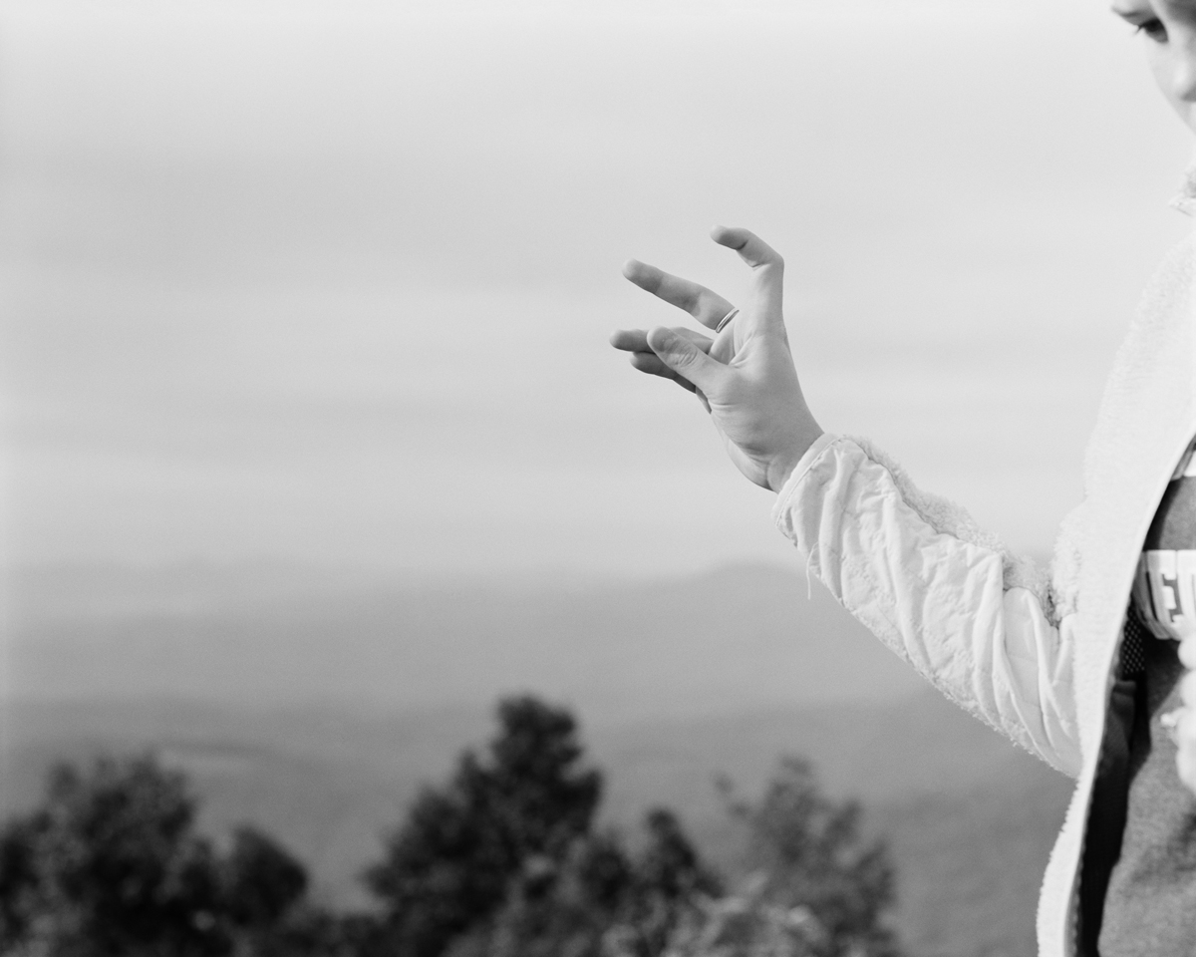
Chapter 7 – Selfies and Selfish
About Service
Self-esteem and the idol of man
What does the Bible say?
Attitude of Service – humility and love
Media Conversations
Discussion Questions
Notes:
Discussion Questions:
Why does the “selfie” have such significance?
How is “selfie” culture at variance with the “selfie” of man in the Bible?
How does the Bible say we ought to deal with our fellow humans? Use texts.
Why is humility such an important attitude in the life of Christian service?
Give examples of Christian service.
What three questions should guide parents on media use?
In what ways can we use media for service to others?

Slide 11
Chapter 8 – Young Love and Sexting
About Faithfulness
Sexting and cyberbullying
What does the Bible say?
Attitude of Faithfulness – trustworthiness
Media Conversations
Discussion Questions
Notes:
Discussion Questions:
Why do young people have trouble foreseeing the consequences of their actions?
Why is cyber-bullying much more powerful than the old-time “school yard” bullying?
Give examples of positive peer pressure.
Explain the meaning and importance of Proverbs 27:12:
What can be the result of not heeding 1 Thessalonians 4:3-4?
How is trustworthiness a part of faithfulness?
If you were Liz’s mother, how would you have dealt with her temptation to sext?
What is the story of Amanda Todd—(do some research!)?
Explain the meaning of the acronym THINK!

Slide 12
Conclusion
Media Avoidance?
Media Circle & Attitudes (next slide)
Conscience Forming
A duty of parents
Hope & Prayer
Stand on the promises of Scripture
Notes:
Discussion Questions:
How does our media usage reflect to which “world” we are strangers?
Why must parents guide their children in media use? Explain in detail.
Why should parents not lose hope in a seemingly hopeless battle against media usage?

Slide 13
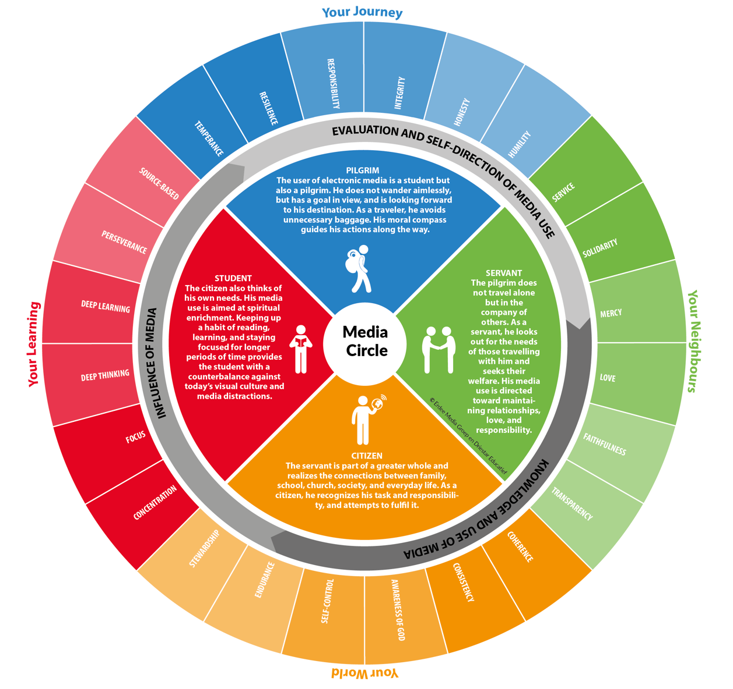
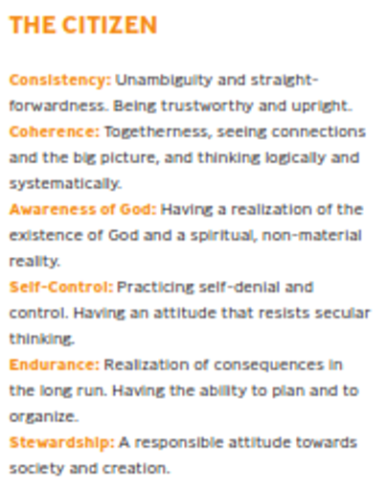
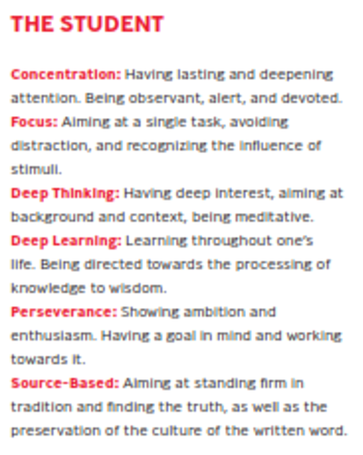
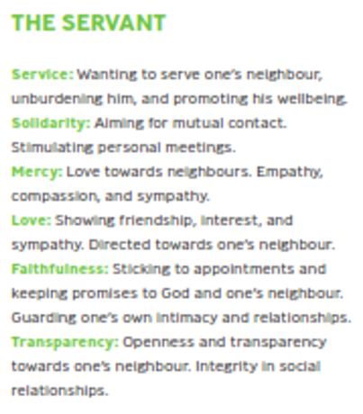
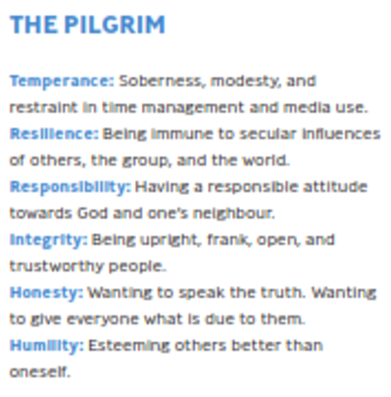

Slide 14
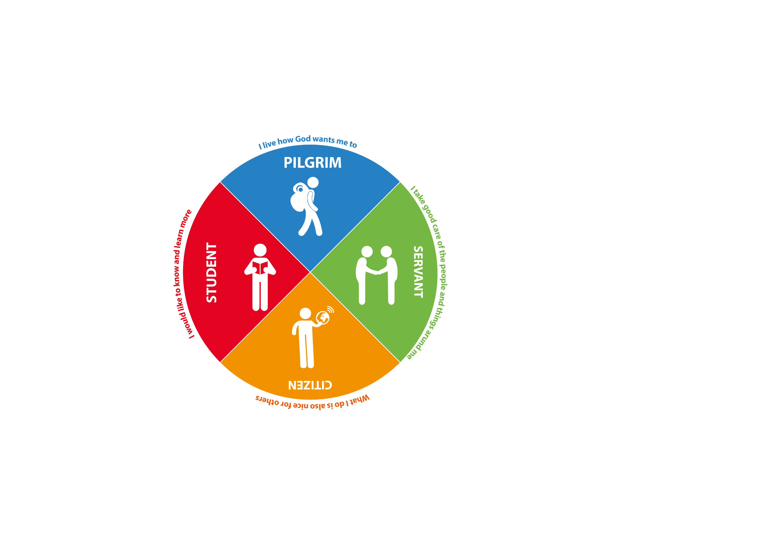
This PowerPoint is based on the book “Pilgrim in Medialand” which was originally produced in the Dutch language by the New Media in Education and Education Lectorate, an initiative of Driestar Educatief and Erdee Media Group.
We are grateful to the authors and publisher for granting permission to
publish this English translation.
© Lethbridge NRC Modern Media Committee 2019
First edition August 2019
Second edition January 2020
Third edition June 2020
English translation of the Dutch second edition October 2017 (revised)
www.modernmedia.nrclethbridge.com
Printed by Warwick Printing Ltd., Lethbridge, Alberta
____________
Information of the Second Edition October 2017
ISBN: 978 94 0290 1535
C-NUR: 740-050
Steef de Bruijn and Henrieke Hoogendijk - van Dam
Title: Pelgrim in medialand
© B.V. Publisher De Banier, Apeldoorn 2017
Cover design and design: Corné van der Horst
Photos: Sjaak Verboom
The use of this PowerPoint is granted for educational purposed only and not be used of reselling or use in other digital platforms.

